Slide 1
The Middle Ages
Modern World History

Slide 2
Learning Targets
Evaluate the impact of the Middle Ages on the people of Europe.
Describe how Feudalism helped create a stable society.
Explain the impact of the Black Death.

Slide 3
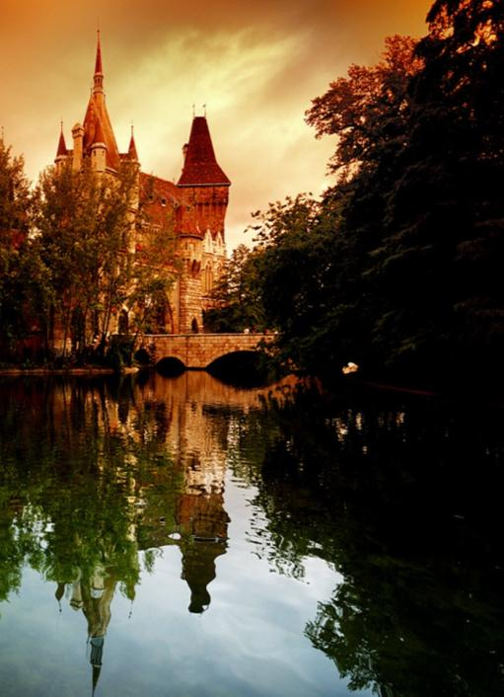
What were the “Middle Ages?”
The 1000-year period of history between the end of the Roman Empire and the Renaissance
Usually refers to Europe
Approx. 500-1500 CE
An era notable for its consistency, “medieval” Europe was very stable
What can cause dramatic changes in the way people live together?
What can cause the way people live together to remain consistent?
What things do we know or associate with the Middle Ages?

Slide 4
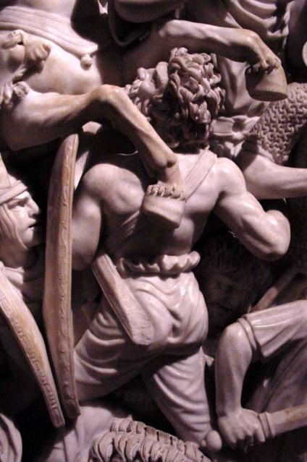
Transforming the Roman World
The once-powerful Roman Empire became unable to defend land from invaders (Visigoths, Huns, Vandals)
Germanic groups moved in, created smaller kingdoms across Europe
Franks, Angles, Ostrogoths, etc.
Christianity had been the official religion of the late Roman Empire
Church officials organized into administrative hierarchies
Priest, bishop, archbishop…
Eventually led to title of pope and new name: Roman Catholic Church
Detail of sculpture depicting the Visigoth invasion of Rome

Slide 5
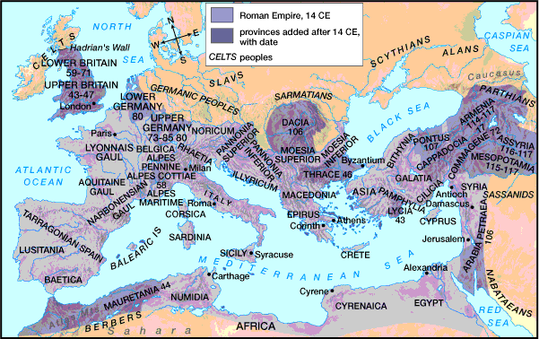
The Greatest Extent of the Roman Empire – 14 CE

Slide 6
The Legacy of Rome
Republic Government
Roman Law
Latin Language
Roman Catholic Church
City Planning
Romanesque Architectural Style
Roman Engineering
Aqueducts
Sewage systems
Dams
Cement
Arch

Slide 7
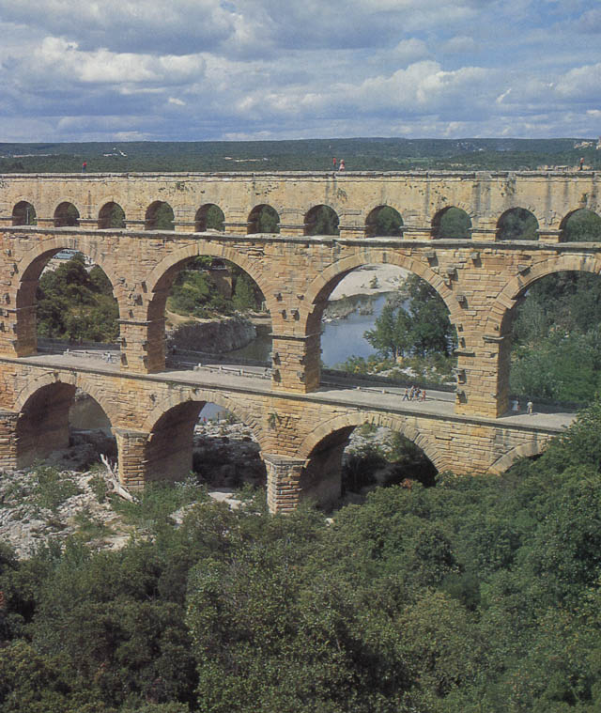
Roman Aqueducts

Slide 8
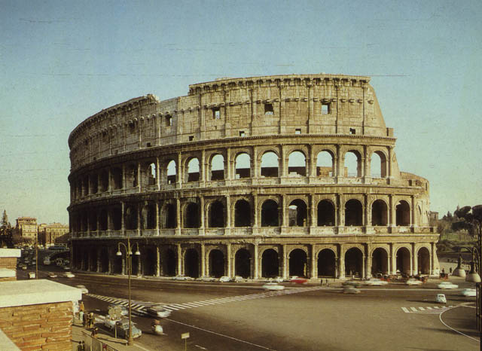
The Roman Colosseum

Slide 9
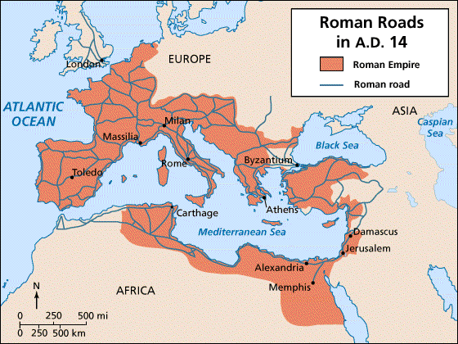
Imperial Roman Road System

Slide 10
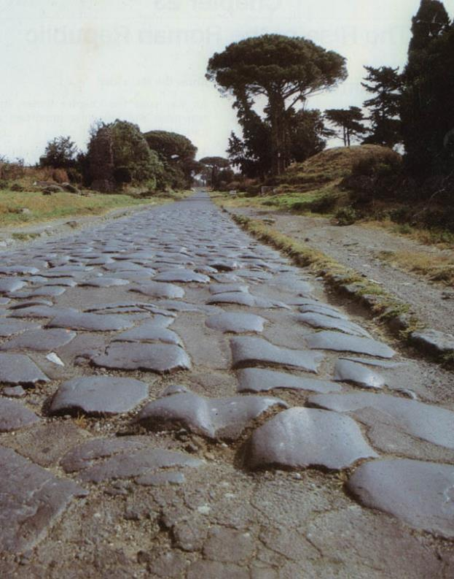
Roman Roads: The Appian Way

Slide 11
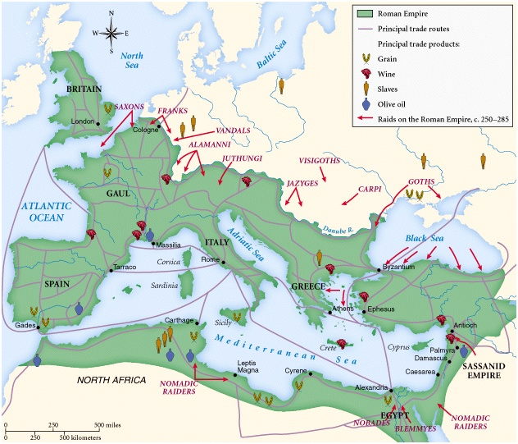
The Empire in Crisis: 3c

Slide 12
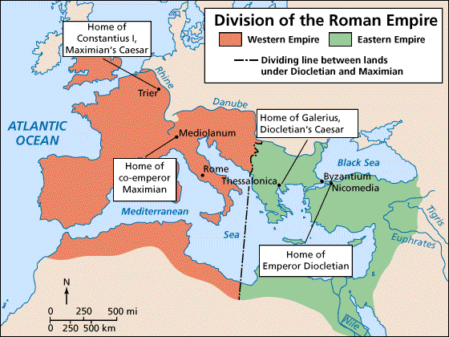
Diocletian Splits the Empire in Two: 294 CE

Slide 13
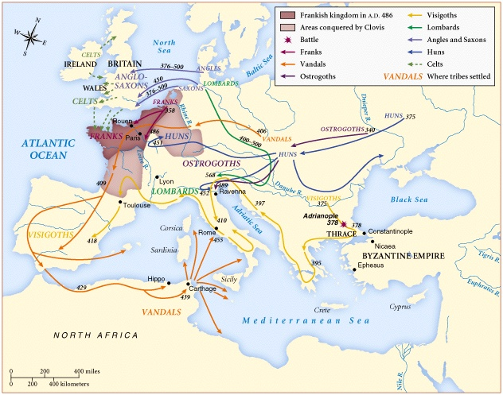
Barbarian Invasions: 4c-5c

Slide 14
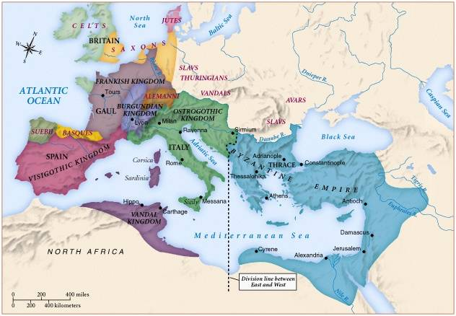
Europe in the 6th Century

Slide 15
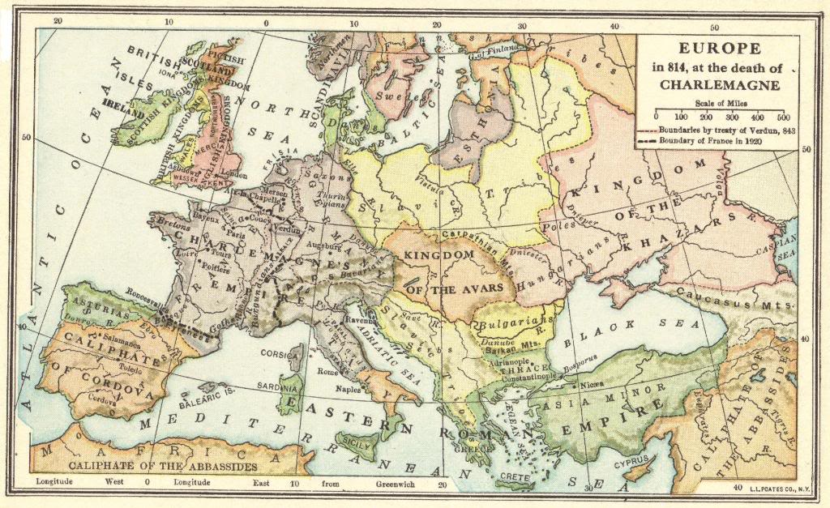

Slide 16
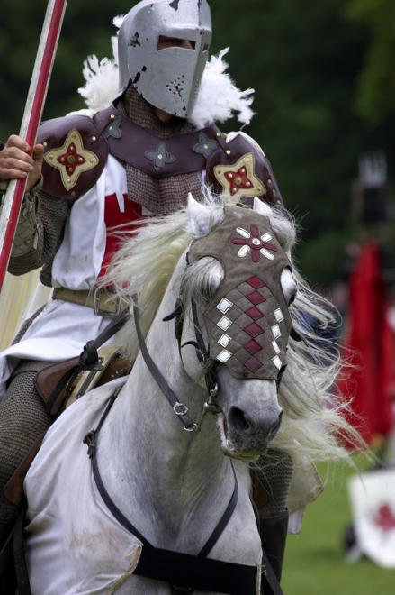
Feudalism
A social/political system of the Middle Ages where nobles offer protection in exchange for services
Raids by Vikings (north), Muslims (south), and Magyars (east) created an increased need for local defense
Noble: member of land-owning family (head of family: “Lord”)
Vassal: man who served lord in a military capacity for land & favors
Knights: heavily armored cavalry
Medieval authority: complicated series of alliances between kings, nobles, warriors (see Magna Carta)
Many vassals served their lords through military service

Slide 17
Life in the Middle Ages
Manoralism =
Economic System
King
Feudalism =
Political System
Fief & Peasants
Lords
(Vassals)
Loyalty & Military Aid
Food & Shelter
Knights
(Vassals)
Military Service
Food, Shelter & Protection
Peasants
(Serfs)
Farm Labor & Rent

Slide 18
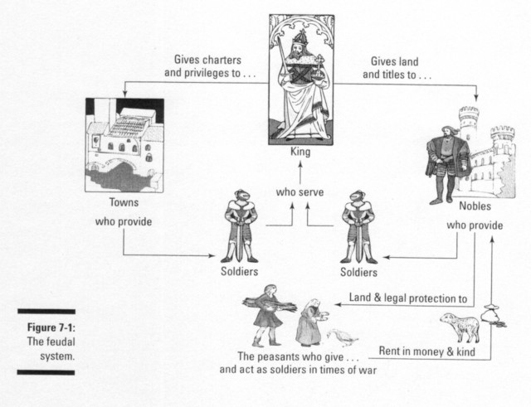

Slide 19
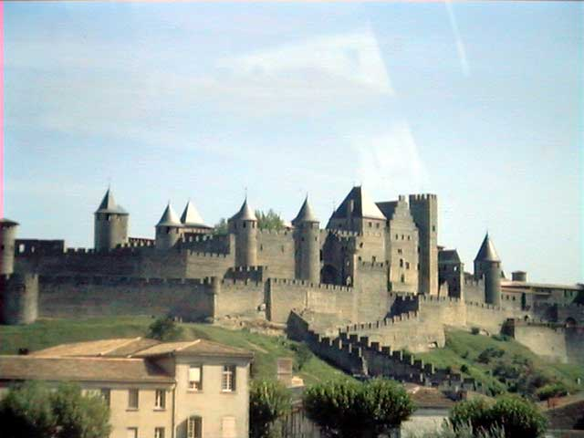
A Medieval Castle in
Carcassonne, France

Slide 20
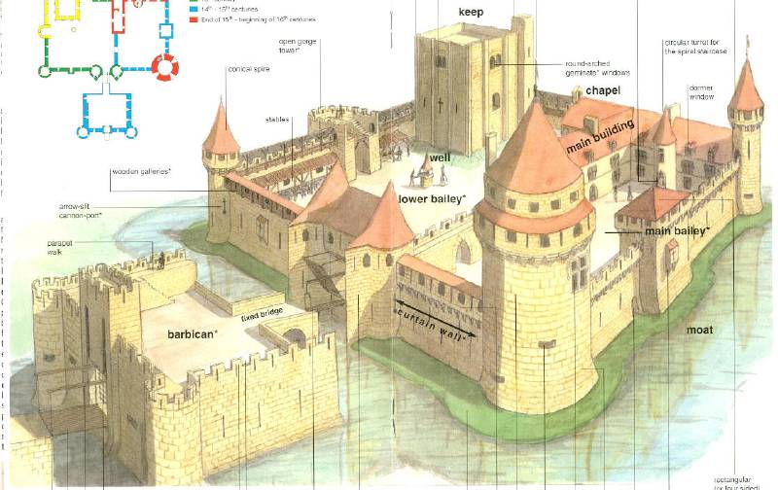
Parts of a Medieval Castle

Slide 21
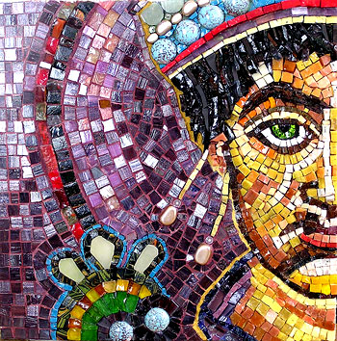
The Byzantine Empire
Eastern Roman Empire Survived
Centered in Constantinople
Linked Europe, Asia, Middle East
Largest medieval European city
Thrived under rule of Justinian
Threatened by Islamic armies & invaders, Empire lost outer lands
Byzantine Empire would rule Balkans (Greece) and Asia Minor for 800 years
Christian church becomes known as the Eastern Orthodox Church
Schism with Rome over popes
Ruled by powerful emperors who had absolute control in Empire
Mosaic of Justinian, emperor of Eastern Roman Empire from 527-565

Slide 22
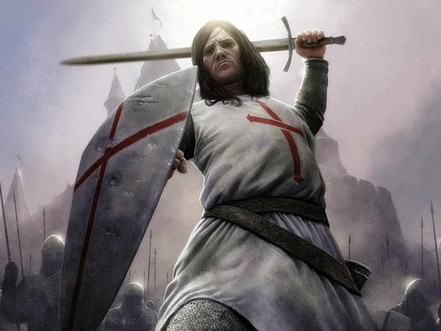
The Crusades
A series of 12th century holy wars between Christians & Muslims over control of The Holy Land (Palestine)
Kingdoms across Europe sent knights to fight at Popes’ requests
First Crusade successful in gaining Jerusalem, surrounding territories
Second Crusade was a total failure
Christians eventually pushed out
Third Crusade led to settlement granting free access to Jerusalem
Fourth Crusade turned into a fight over control of Constantinople
Armies across Europe united in an attempt to claim the Holy Land from Muslim control

Slide 23
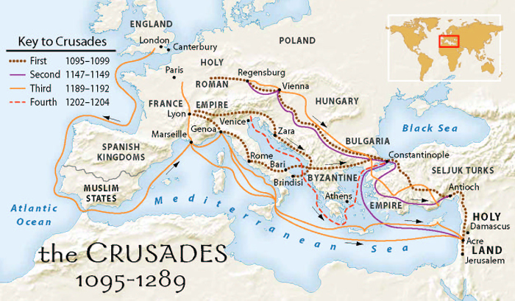

Slide 24
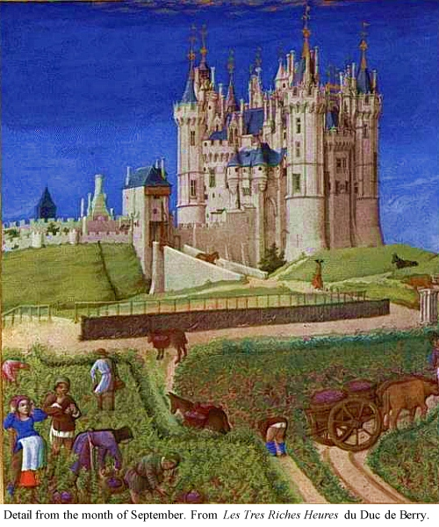
Feudalism, part II
What about the people who weren’t kings, lords, vassals, or knights?
Most people were the lowest class known as peasants, many of whom worked the land as farmers
Provided food for upper classes in exchange for protection & order
Most land was divided into large tracts called manors owned by lords
Serf: a peasant who became legally obligated to work on Lord’s manor
Serf had to share harvest, work the lord’s land, pay many other fees
Lord’s duty to protect his serfs

Slide 25
Exit Ticket
STOP
How did feudalism create a stable society?
List 2 ways

Slide 26
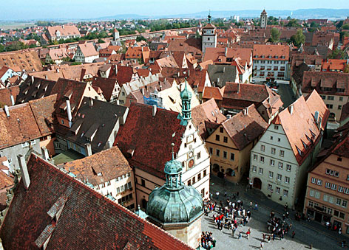
Life in the Medieval Cities
Revival of European trade in 10th century caused cities to grow
Venice, Italy emerged as the trade center of Mediterranean Sea
Wool of Flanders (north coast of France) fueled northern trade
Money economy replaced bartering
Commercial capitalism: investing in trade for the purpose of profit
Townspeople paid lords for special rights (buy/sell property)
Walls built around cities for defense
Most medieval cities were smaller in pop. than Lawrence
Medieval neighborhood of Rothenburg, Germany

Slide 27
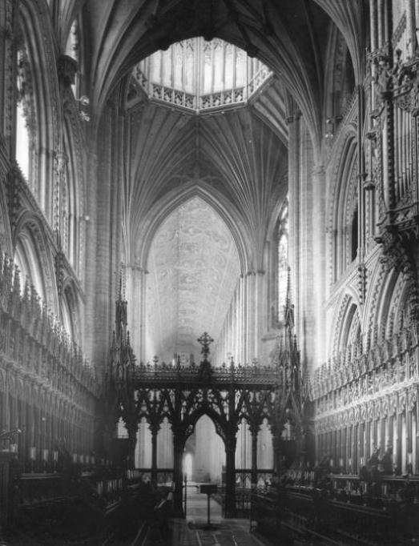
The Power of the Pope
Catholic Church contained number of offices, appointed by nobles
Meant bishops, abbots, etc. were often vassals, obligated to nobility
Duties more political than spiritual
Church officials not free to run church as they like in feudal system
Pope Gregory I vs. Henry IV
Popes gained more political power
As “Gods vicar on Earth,” Popes claimed authority over kings
Used the Inquisition to enforce decrees, fight heresy in church
Interior of Ely Cathedral, completed 1375AD

Slide 28
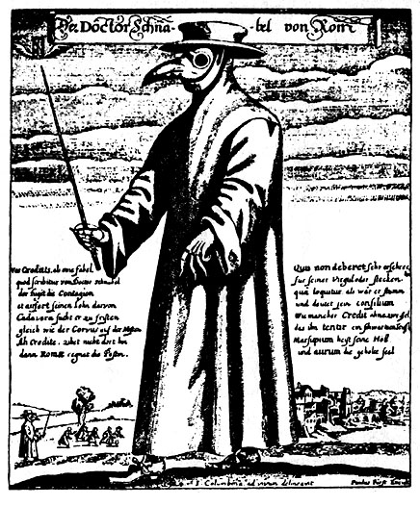
The Black Death
1348-1351: Most devastating natural disaster in European history
Cause unknown (at the time), aka Bubonic Plague killed over 30 mil.
Plagues often seen as God’s wrath
Public turned to Church for answers
Death seemed to follow trade routes
Italian merchants carried it from Black Sea, spread across Europe
Plague had wide-ranging impacts
Created wave of anti-Semitism
Loss of population led to high demand for labor, low food prices
Peasants had more economic power
Physician’s uniform designed to prevent contracting the Bubonic Plague

Slide 29
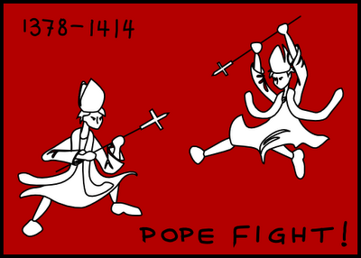
A Decline in Church Power
European kings challenge papal claims to supreme authority
King Philip IV of France defied pope, tried to tax French clergy
When pope died, Philip “elected” new French pope under his rule
“Avignon” popes unpopular
Pope eventually returned to Italy
Italians reject French Pope, elected one of their own
The Great Schism: Catholic Church had two supreme leaders, each excommunicating the other
Hurt authority, credibility of popes

Slide 30
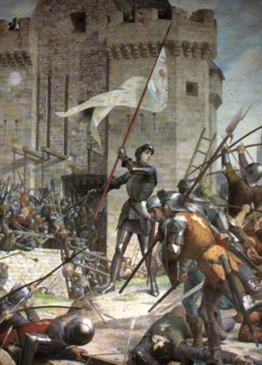
The Hundred Years War
1337-1453: France and England battled over territory, pride
Began as a battle of knights, turned into brutal battle of peasant soldiers
England won battles, could never conquer all of France
17-year-old French peasant, Joan of Arc, inspired new king, armies to victory with her spiritual visions
Joan captured, executed as heretic
Political Recovery in 15th Century
New monarchies established
France, England, Spain stronger
Holy Roman Empire fails to unite
Painting of Joan of Arc at Battle of Orleans

